Slide 1
Video Game Sales Dashboard
A Data-Driven Analysis of Global Video Game Sales
presented by – Soham Kulkarni

Slide 2
Dataset Overview
This dataset contains video game sales data categorized by platform, genre, publisher, and sales across different regions such as North America, Europe, Japan, and other regions.

Slide 3
Key Sales Metrics
- Total Global Sales: 8920.44 Million
- Total North America Sales: 4392.95 Million
- Total Europe Sales: 2434.13 Million
- Total Japan Sales: 1291.02 Million
- Total Global Sales by publisher : 1.89 Million

Slide 4
Top Genres by Global Sales
- Action: 1751.18 Million
- Sports: 1330.93 Million
- Shooter: 1037.37 Million
- Role-Playing: 927.37 Million
- Platform: 831.37 Million
- Misc: 809.96 Million
- Racing: 732.04 Million
- Fighting: 448.91 Million
- Simulation: 392.20 Million
- Puzzle: 244.95 Million
- Adventure: 239.04 Million
- Strategy: 175.12 Million

Slide 5
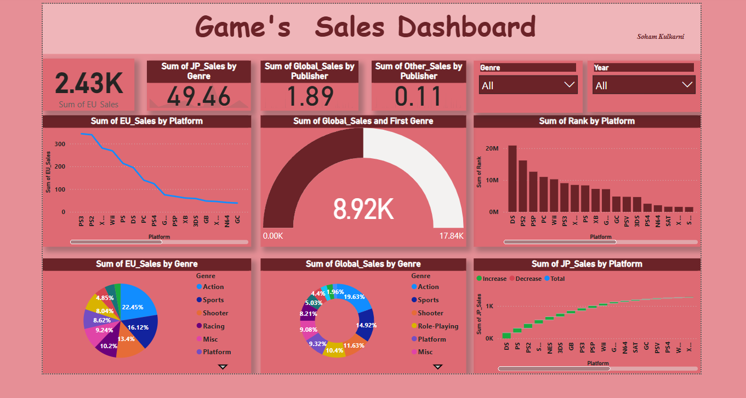
Dashboard

Slide 6
Top Platforms by Global Sales
- PS2: 1255.64 Million
- X360: 979.96 Million
- PS3: 957.84 Million
- Wii: 926.71 Million
- DS: 822.49 Million
- PS: 730.66 Million
- GBA: 318.50 Million
- PSP: 296.28 Million
- PS4: 278.10 Million
- PC: 258.82 Million

Slide 7
Conclusion & Takeaways
- Action and Sports genres dominate the gaming market.
- Platforms like DS, PS2, and Wii have high global sales.
- Regional preferences vary, with Japan favoring Role-Playing games.
- North America leads in sales, followed by Europe and Japan.

Slide 8
Thank you !

